Slide 1
One Dimensional Motion
The Area Under the Curve

Slide 2
The Last Lecture
During the last two lectures, we discussed:
  The use of algebra to derive the “BIG FIVE”
  We also investigated how derivative calculus can be used to make sense of the motion of objects such as an elevator.
Today we will discuss the significance of the “Area Under the Curve”

Slide 3
Let us recall the motion of the elevator.
The graph shows that the position vs. time follows a non-linear (polynomial) relationship from 1-3 and 8-11 seconds, and a constant change from 3-8 seconds.
y = -0.65t² + 14.31t - 48.82
y = 4.00t - 8.00
With the exception of the first and last second of the dataset, the motion of the elevator can be broken up into three distinct segments:
  Positive acceleration from 1 – 3 s
  Constant velocity from 3 – 8 s
  Negative acceleration from 8 – 11s
y = t² – 2.00t + 1.00

Slide 4



If you calculate the area under the curve from 1 – 11 seconds, what do you get?
It should be clear by now that the area under a velocity vs. time curve equals the displacement of the object.
$$A1=½ b∗h$$
$$d=½ v∗t$$
$$d=vavg∗t$$
$$d=½ (4m/s)(2s)$$
$$d=4 meters$$
$$A3=½ b∗h$$
$$d=½ (4m/s)(3s)$$
$$d=6 meters$$
$$A2= b∗h$$
$$d=v∗t$$
$$d=(4m/s)(5s)$$
$$d=20 meters$$
The total vertical displacement is equal to the sum of the areas: $dtotal=A1+A2+A3=4m+20m+6m=30m$

Slide 5
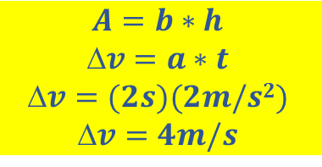

If you calculate the area under the curve from 1 – 3 and 8 – 11 seconds, what do you get?
As should be clear once again, the area under an acceleration vs. time graphs equates to the change in velocity of the object.
$$A=b∗h$$
$$v=a∗t$$
$$v=(3s)(−1.3m/s2)$$
$$v=\sim −4m/s$$
$$A=b∗h$$
$$v=a∗t$$
$$v=(2s)(2m/s2)$$
$$v=4m/s$$
Note: If you add the two areas together, you get zero, which tells you that the initial and final velocities should be the same. In this case, it is zero.

Slide 6











When the acceleration is uniform or constant, the area under a velocity vs. time curve, and an acceleration vs. time curve are easy to calculate.
  When the acceleration is zero or constant, the position of the particle will follow a first or second order polynomial, respectively.
Constant Velocity
$$x−xo=vot$$
First Order
Constant Acceleration
$x−xo=vot+ \frac{1}{2}at$²
Second Order
$$x=2.0+2.0t$$
$$v=2$$
$$a=3$$
$$x=5.0+2.0t+1.5t2$$
$$v=2.0+3.0t$$
$$A=\frac{1}{2}b×h$$
$$A=b×h$$
$$A=b×h$$
$$a=0$$
$$A=b×h$$

Slide 7

  However, what if the position vs. time of a particle does not follow a first or second order polynomial relationship?
Acceleration not constant
$$x=3t−4t2+t3$$
Third Order

Slide 8




Now that we know what the area under the curve represents, how do you calculate it?
We can break up the area into individual rectangles and add those areas up.
$$A2=b∗h$$
$$x2=v∗t$$
$$x2=(5.75m/s)(10s)$$
$x2=$ $57.5m$
$x3=$ $57.5m$
$$A1=b∗h$$
$$x1=v∗t$$
$$x1=(2.5m/s)(10s)$$
$x1=$ $25m$
$x1=$ $25m$
The total displacement is: $xtotal=x1+x2+x3+x4=25m+57.5m+57.5+25m=165m$

Slide 9








Repeating the process using a smaller time interval
We will now reduce the time interval by a factor of 2 by going from 10s to 5s.
$$59.75m$$
$$59.75m$$
$$52.0m$$
$$52.0m$$
$$36.75m$$
$$36.75m$$
$$13.5m$$
$$13.5m$$
Recalculating the area: $xtotal=x1+x2+…x8=13.5m+36.75m+52.0+59.75m+…=162m$

Slide 10
We can repeat this process again and again infinitely producing a smaller and smaller time interval each and every iteration.

Slide 11
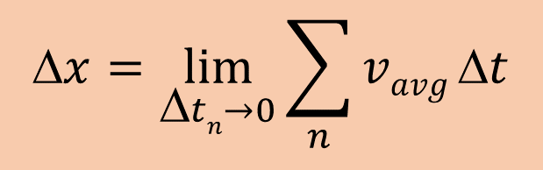


Note that the area better approximates the displacement of the object as the time interval decreases. This is especially noticeable near the peak velocity.
$$x=\lim_{Δtn→0}{\sum_{n}{vavg}Δt}$$
$$vavg$$
(for the interval)
$$tn$$

Slide 12
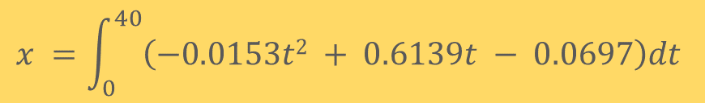
In calculus, if we know the formula, we can calculate the area under the curve through integration
$$x =\int_{0}^{40}{\left(−0.0153t2 + 0.6139t − 0.0697\right)dt}$$
$$v = −0.0153t2 + 0.6139t − 0.0697$$
$x =$ $0.0051t3 + 0.3070t2 − 0.0697t$
$x =$ $\left(\frac{−0.0051m}{s3}\right)\left(40s\right)3 +\left(\frac{0.3070m}{s2}\right)\left(40s\right)2 −\left(\frac{0.0697m}{s}\right)\left(40s\right)=162m$

